Slide 1
ENDOSCOPIC MANAGEMENT OF BARIATRIC-METABOLIC SURGERY COMPLICATIONS: EXPERIENCE OF THREE SICILIAN CENTERS
PIETRO GRACEFFA
OSP. BUCCHERI LA FERLA,FATEBENEFRATELLI PALERMO

Slide 2
ENDOSCOPIC MANAGEMENT OF BARIATRIC-METABOLIC SURGERY COMPLICATIONS: EXPERIENCE OF THREE SICILIAN CENTERS
Granata A. (1), Graceffa P. (1), Callari C. (2), Cartabellotta F. (3), Piazza L. (4), Rizzo G.E.M. (5), Traina M. (5)
(1) Interventional Endoscopic Unit, Buccheri La Ferla Hospital, Fatebenefratelli (Palermo);
(2) Center of Excellence SICOB, Buccheri La Ferla Hospital (Palermo); 3) Department of Internal Medicine, Buccheri La Ferla Hospital, Fatebenefratelli (Palermo);
(4) Department of Surgery, ARNAS Garibaldi (Catania); (5) Endoscopy Unit, Department of Diagnostic and Therapeutic Services, IRCCS-ISMETT (Palermo)

Slide 3
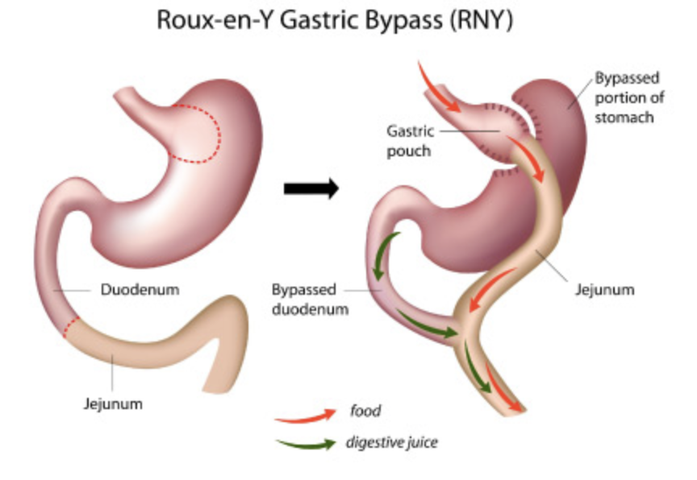
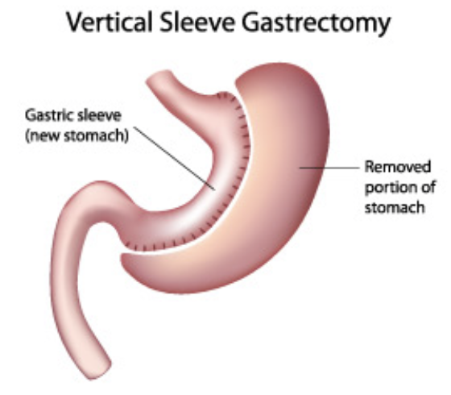
Background
Obesity is now a pandemic and the prevalence of people living with obesity
continues to increase [1].
Bariatric and metabolic surgery (BMS): the most effective and durable therapy for weight loss and improvement of associated comorbidities.
The most performed procedure is laparoscopic sleeve gastrectomy (LSG) followed by Roux-en-Y gastric bypass (RYGB) and revisional surgery [2]
Familiarity with the management of procedure-related complications is increasingly important for endoscopists [3].
Ward ZJ et al. Projected U.S. State-Level Prevalence of Adult Obesity and Severe Obesity. N Engl J Med 2019
American Society for Metabolic and Bariatric Surgery (ASMBS). Estimate of bariatric surgery numbers, 2011-2019
de Moura DTH et al Status of bariatric endoscopy-what does the surgeon need to know? World J Gastrointest Surg 2022

Slide 4
Background
Leak’s definition: «transmural defect with communication between the intra and extraluminal compartments».
Early (< 48–72 h)
Intermediate (3–30 days)
Late (> 30 days)
Fistula’s definition: «abnormal communication between two epithelialized surfaces».
Internal fistula: between two internal epithelialized organs
External fistula: between an internal organ and the skin surface [5].
de Moura DTH, Sachdev AH, Thompson CC. Endoscopic Full-Thickness Defects and Closure Techniques. Curr Treat Options Gastroenterol 2018

Slide 5
Background (Pathophysiology)
Leak’s post-LSG: High pressure on the proximal side of the suture, angle of the gastric tubule and ischemia [10].
Constant stream of fluid→ Patency of the defect and apposition of fibroblastic cells
Most post-LSG leaks occur at the angle of His (highest pressure zone)
Most post-RYGB leaks extend to the left of GJ anastomosis [11]
Parikh MS et al Objective comparison of complications resulting from laparoscopic bariatric procedures. J Am Coll Surg 202:252–261
Marc S, Levine LRC (2014) Imaging of bariatric surgery: Normal anatomy and postoperative complications. Radiology 270:2

Slide 6
Background (Treatment)
Regardless of the chosen technique, the management of leaks and fistulae requires a multi-disciplinary approach.
Clinically stable patient: Endoscopy evaluation is recommended
Unstable patients and infected collection→ Laparoscopic drainage
Clinical management→Drainage (in case of collection)→Treatment of associated factors→Promoting the healing of the defect
Nutrition should be introduced as early as feasible and enteral nutrition is the
preferred option (Nasoenteral feeding tube distal to the defect).
Intravenous antimicrobial therapy

Slide 7
Aim of the study
Early clinical success: significative clinical/humoral response and a significative reduction of the related collections at 7 days post-endoscopic intervention.
Long-term clinical success: complete resolution of the wall defect and of the related collections at 3-month of follow-up
Safety of the endoscopic procedures

Slide 8
Matherials and Methods
Retrospective-observational study
Three tertiary centers (ISMETT, University of Pittsburgh Medical Center, Palermo, Italy; Buccheri La Ferla Hospital, Palermo, Italy; ARNAS Garibaldi, Catania).
All patients referred between October 2017 and September 2023 were retrospectively included.
Follow-up was conducted at 1 month and 3 months
We collected data on:
Age; Sex; Time from surgery to endoscopy intervention;
Previous endoscopy and/or radiology and/or surgery;
Size, position and type of the defect; On-site drainage;
Presence of collection; Endoscopic treatment;
Early and long-term clinical success; AE and complications;
Further endoscopic and/or surgical intervention

Slide 9
Management
Diagnosis:
Clinical signs/symptoms
Blood Tests
CE Computed Tomography
Supportive Care:
Enteral and parenteral nutrition
Pain control
IV Fluids
Empirical broad-spectrum antibiotic therapy
Unstable patient→Surgical drainage
Stable patient→ Endoscopic procedure.

Slide 10
Management
The included patients were treated in a hybrid operating room equipped with:
Endoscopic and surgical devices
Dynamic X-ray device with a C-arm.
Patients were placed in a supine position
and under general anesthesia.
Initial diagnostic endoscopy
Pre-procedural enteral dynamic contrast dye

Slide 11
Management
Post BMS GI complications
Supportive therapy (*)
Antibiotics
Fistula
Leak
Drainage in place
No Drainage in place
To Drain (ET):
-EID (Double pig tail stent)
To Drain:
Radiological Drainage
-Pure suture
-Anchoring FC SEMS
-BMS designed FC SEMS
-Pure Suture
-Anchoring FC SEMS
-BMS designed FC SEMS
*If clinically unstable→Surgery

Slide 12
Results
Patients n° 39
Mean Age of 43.6 years (±11.45).
Sex Ratio M/F 9/39 (76.9%)
Mean time of the defect’s evidence from surgery of 7 days (IQR 7.25)
Most common type of defect: Leaks 29/39 (75%)
Most common type of BMS: Sleeve Gastrectomy 31/39 (79.5%)
Notes:
Clinical success was defined as short-term (1-month follow-up with clinical and biochemical examinations, gastroscopy or colonoscopy, or radiological imaging such as CT or oral contrast dye) and long-term (complete resolution of the wall defect as evidenced by clinical evaluation at 6 months follow-up). Long-term clinical success following first endoscopic intervention was 71% (12/17 patients). The complication rate was 30%: 4/5 represented by stenosis of the distal esophagus completely resolved with the placement of endoluminal LAMS and 1/5 represented by a malpositioning of the double pig tail, effectively resolved with the simple endoscopic removal of the latter (Table 2).

Slide 13
Results
Technical success: 37/39 (94.9%)
Early clinical success: 27/36 (75%)
Long-term clinical success: 30/30 (100%)
Re-surgery post ET failure was observed only in 1 patient.
Complications Rate: 5/39 (12.8%):
Stenosis of the distal esophagus resolved with the placement of endoluminal LAMS→4/5
Malpositioning of double pigtail resolved with the simple endoscopic removal of the stent→1/5
Notes:
Clinical success was defined as short-term (1-month follow-up with clinical and biochemical examinations, gastroscopy or colonoscopy, or radiological imaging such as CT or oral contrast dye) and long-term (complete resolution of the wall defect as evidenced by clinical evaluation at 6 months follow-up). Long-term clinical success following first endoscopic intervention was 71% (12/17 patients). The complication rate was 30%: 4/5 represented by stenosis of the distal esophagus completely resolved with the placement of endoluminal LAMS and 1/5 represented by a malpositioning of the double pig tail, effectively resolved with the simple endoscopic removal of the latter (Table 2).

Slide 14
Conclusions
The key is the MD approach (experienced endoscopists, surgeons, interventional radiologists…)
Our study had a high overall success rate: advanced endoscopic methods are less invasive and there are more physiological approaches to the management of GI leaks and fistulas.
Prospective studies comparing endoscopic and surgical management of anastomotic leakage and fistula should be proposed (absence of clear guidelines)
However, some leaks and fistulas are difficult to treat with an endoscopic approach, despite significant progress in the field of endoscopy.

Slide 15
Grazie

